Slide 1
Statistics in Python

Slide 2
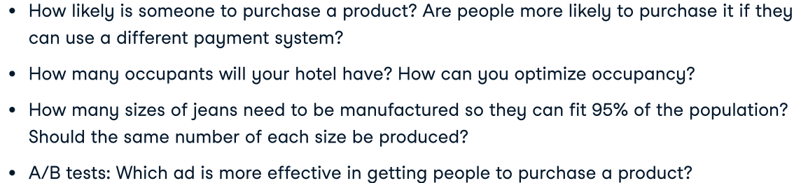
What is statistics?
The field of statistics – the practice and study of collecting and analyzing data.
A summary statistics – a fact about or summary of some data.
What can statistics do?

Slide 3
What can’t statistics do?
Why is Game of Thrones so popular?
Instead…
Are series with more violent scenes viewed by more people?
But…
Even so, this can’t tell us if more violent scenes lead to more views.

Slide 4
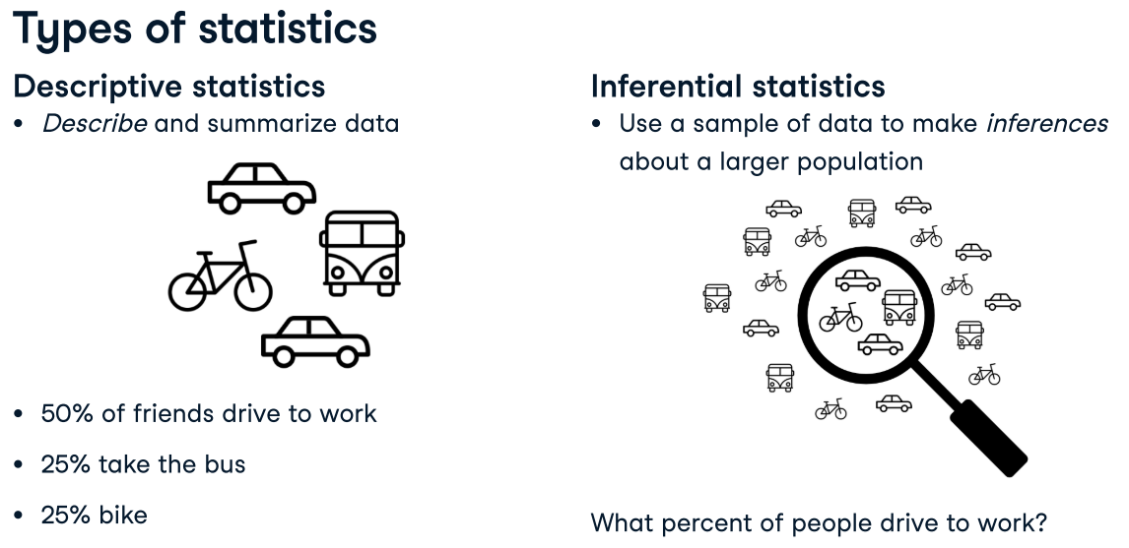
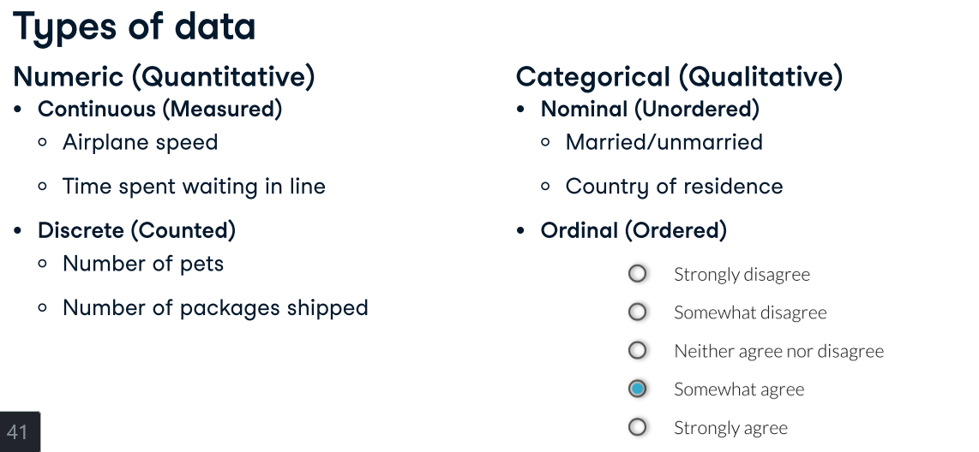
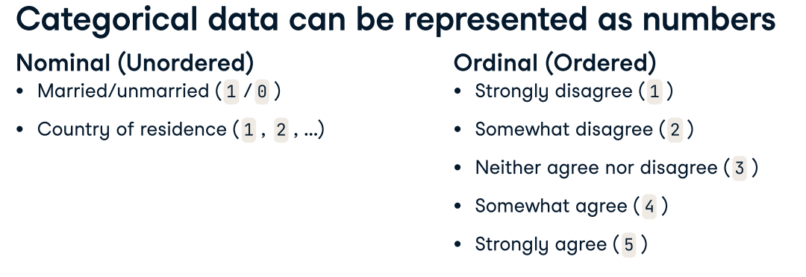
Being able to identify data types is important since the type of data you're working with will dictate what kinds of summary statistics and visualizations make sense for your data, so this is an important skill to master. For numerical data, we can use summary statistics like mean, and plots like scatter plots, but these don't make a ton of sense for categorical data.

Slide 5
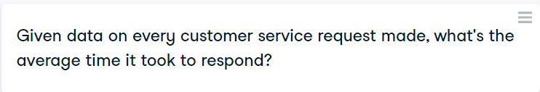




Slide 6
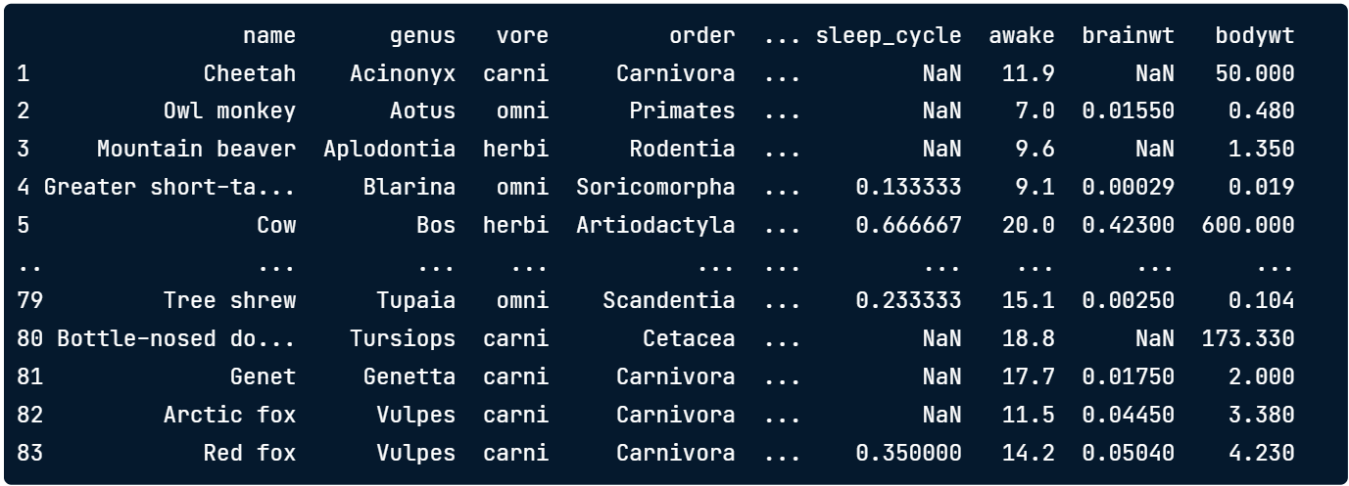
Measures of center
Consider the following data about different mammals' sleep habits.

Slide 7
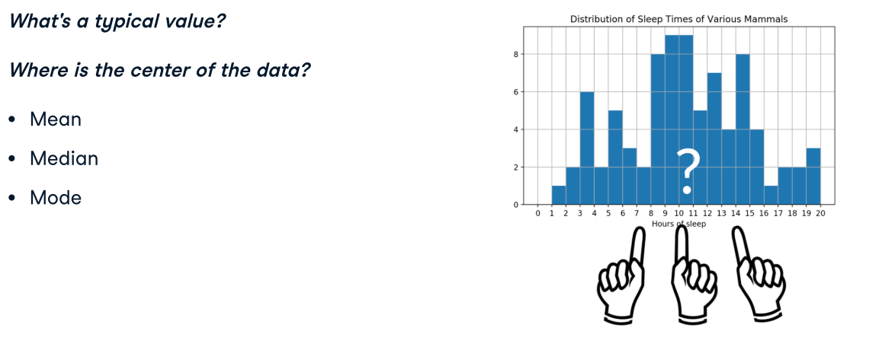
How long do mammals in the dataset typically sleep?

Slide 8
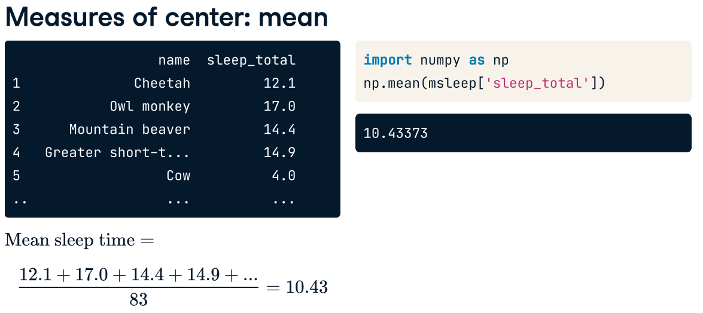

Slide 9
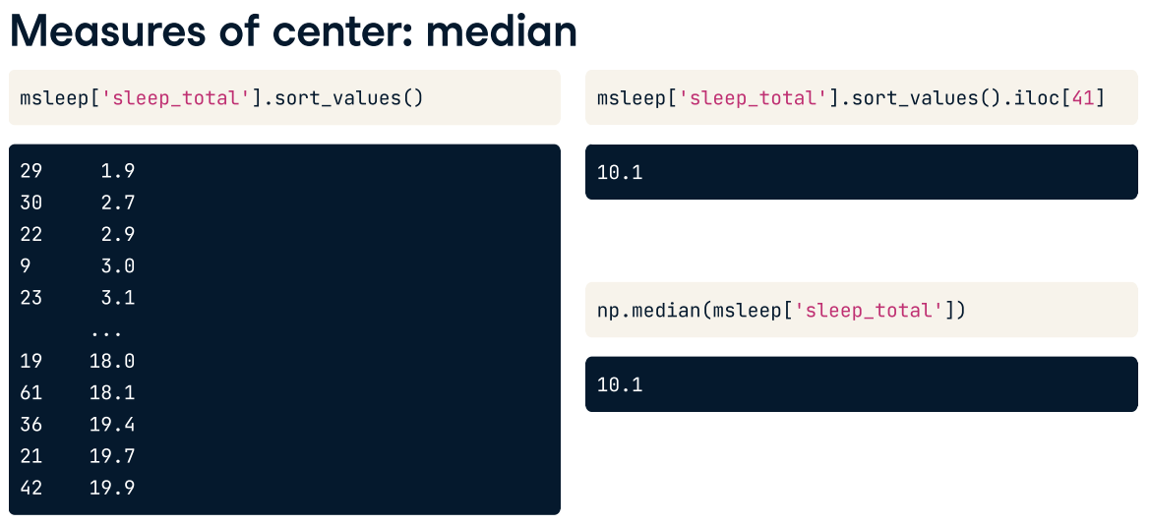

Slide 10
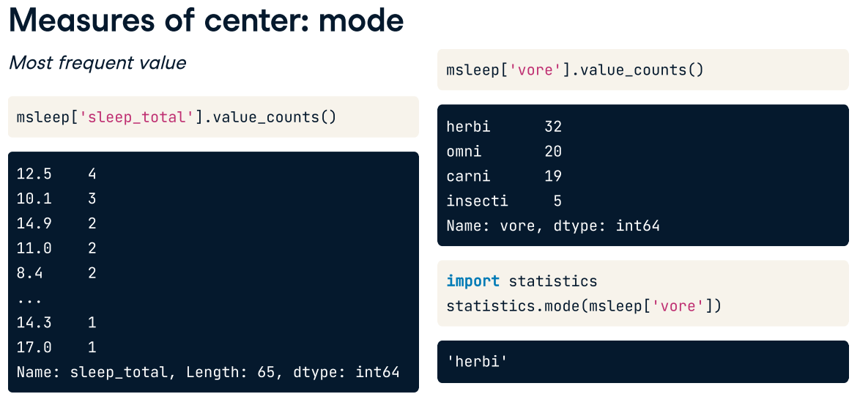

Slide 11
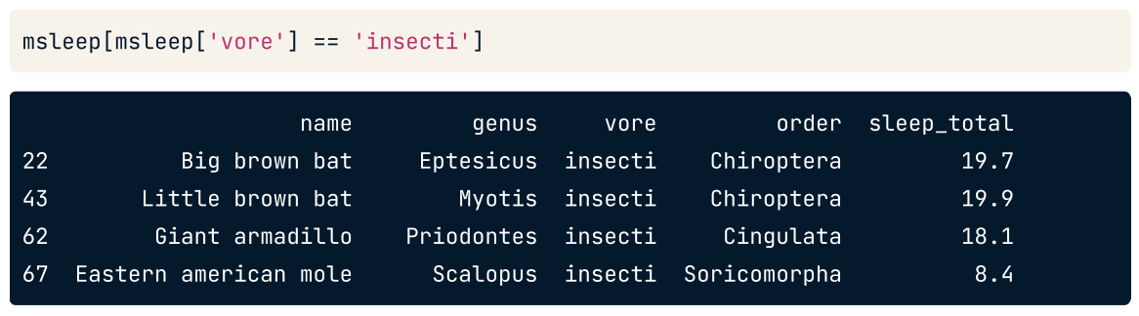
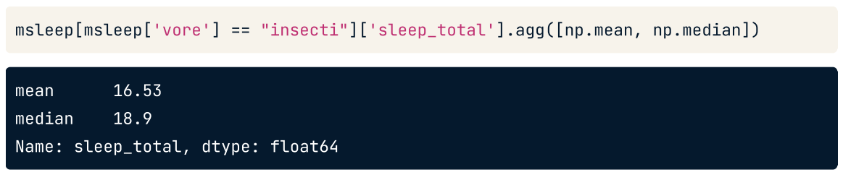
Effects of outliers

Slide 12
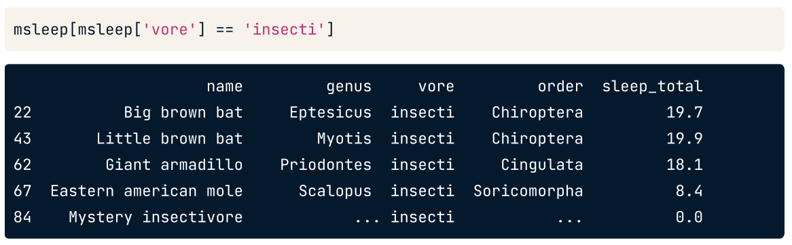
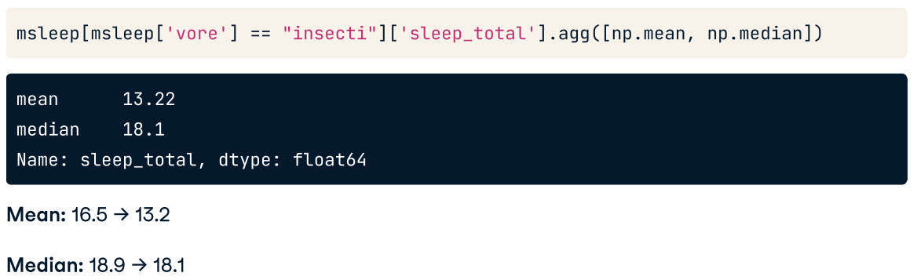

Slide 13
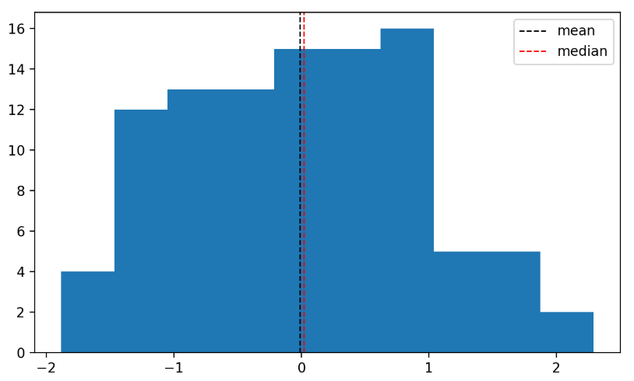
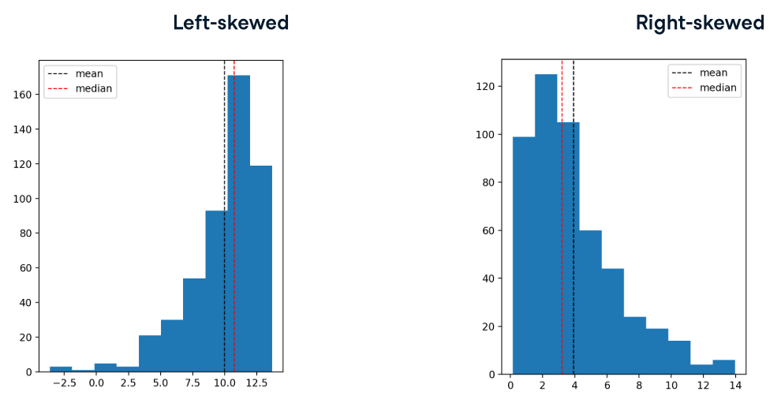
Which measure (mean vs. median) to use?
When data is skewed, the mean and median are different. The mean is pulled in the direction of the skew, so it's lower than the median on the left-skewed data, and higher than the median on the right-skewed data. Because the mean is pulled around by the extreme values, it's better to use the median since it's less affected by outliers.

Slide 14
Try
The food_consumption dataset contains information about the kilograms of food consumed per person per year in each country in each food category (consumption) as well as information about the carbon footprint of that food category (co2_emissions) measured in kilograms of carbon dioxide, or CO2, per person per year in each country.
In this exercise, you'll compute measures of center to compare food consumption in the US and Belgium using your pandas and numpy skills.
Instructions#1
Create two DataFrames: one that holds the rows of food_consumption for 'Belgium' and another that holds rows for 'USA'. Call these be_consumption and usa_consumption.
Calculate the mean and median of kilograms of food consumed per person per year for both countries.
Instructions#2
Subset food_consumption for rows with data about Belgium and the USA.
Group the subsetted data by country and select only the consumption column.
Calculate the mean and median of the kilograms of food consumed per person per year in each country using .agg().

Slide 15
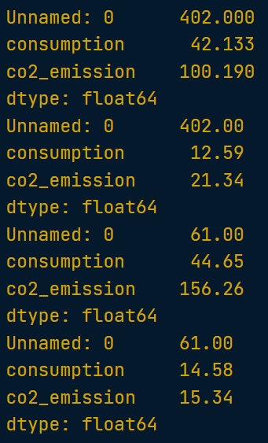
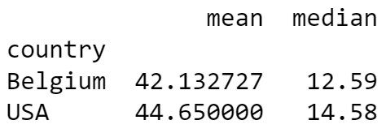
# Task 1
# Import numpy with alias np
import pandas as pd
import numpy as np food_consumption = pd.read_csv('food_consumption.csv’)
# Filter for Belgium
be_consumption = food_consumption[food_consumption['country']=='Belgium’]
# Filter for USA
us_consumption = food_consumption[food_consumption['country']=='USA’]
numeric_cols_be list(be_consumption.select_dtypes(include=np.number).columns)
numeric_cols_us = list(us_consumption.select_dtypes(include=np.number).columns)
# Calculate mean and median consumption in Belgium
print(be_consumption[numeric_cols_be].agg('mean'))
print(be_consumption[numeric_cols_be].agg('median'))
# Calculate mean and median consumption in USA
print(usa_consumption[numeric_cols_us].agg('mean'))
print(usa_consumption[numeric_cols_us].agg('median'))
# Task 2
# Import numpy as np
import numpy as np
# Subset for Belgium and USA only
be_and_usa = food_consumption[(food_consumption['country']=='Belgium’) | (food_consumption['country']=='USA')]
# Group by country, select consumption column, and compute mean and median
print(be_and_usa.groupby('country')['consumption'].agg['mean', 'median']))

Slide 16
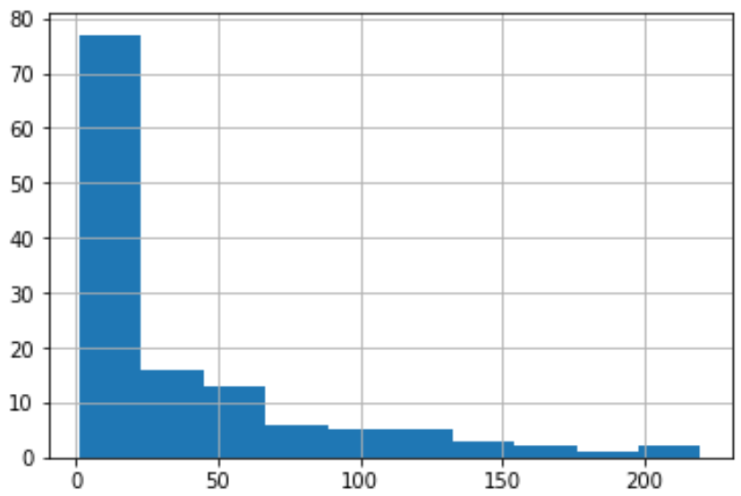
Mean vs. Median
Import matplotlib.pyplot with the alias plt.
Subset food_consumption to get the rows where food_category is 'rice', and save the result to rice_consumption.
Create a histogram of co2_emission for rice and show the plot.
Use .agg() to calculate the mean and median of co2_emission for rice.
# Import matplotlib.pyplot with alias plt
import matplotlib.pyplot as plt
%matplotlib inline
# Subset for food_category equals rice
rice_consumption = food_consumption[food_consumption['food_category'] == 'rice']
# Histogram of co2_emission for rice and show plot
rice_consumption['co2_emission'].hist()
plt.show()
# Subset for food_category equals rice
rice_consumption = food_consumption[food_consumption['food_category'] == 'rice']
# Calculate mean and median of co2_emission with .agg()
print(rice_consumption['co2_emission'].agg(['mean', 'median']))
Left- or Right-Skewed?

Slide 17
# Import matplotlib.pyplot with alias plt
import matplotlib.pyplot as plt
%matplotlib inline
# Subset for food_category equals rice
rice_consumption = food_consumption[food_consumption['food_category'] == 'rice']
# Histogram of co2_emission for rice and show plot
rice_consumption['co2_emission'].hist()
plt.show()
# Subset for food_category equals rice
rice_consumption = food_consumption[food_consumption['food_category'] == 'rice']
# Calculate mean and median of co2_emission with .agg()
print(rice_consumption['co2_emission'].agg(['mean', 'median']))

Slide 18
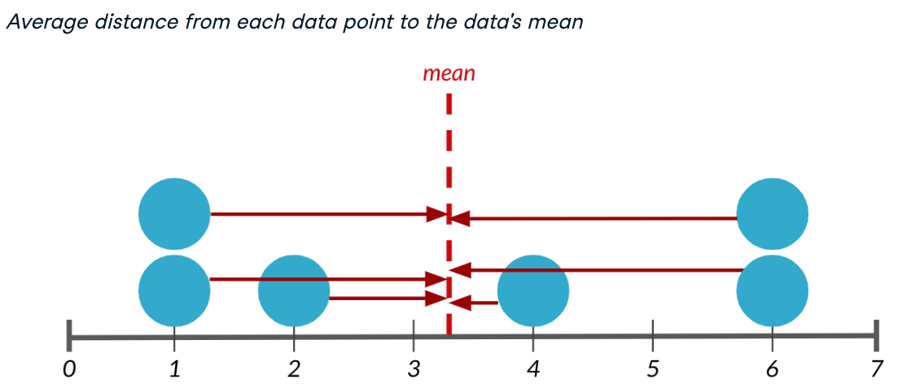
Measures of spread
What is spread?
Spread is just what it sounds like - it describes how spread apart or close together the data points are. Just like measures of center, there are a few different measures of spread.
Variance - measures the average distance from each data point to the data's mean.

Slide 19
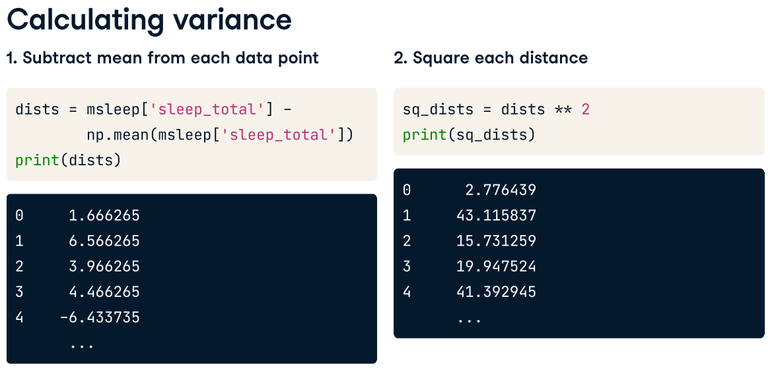
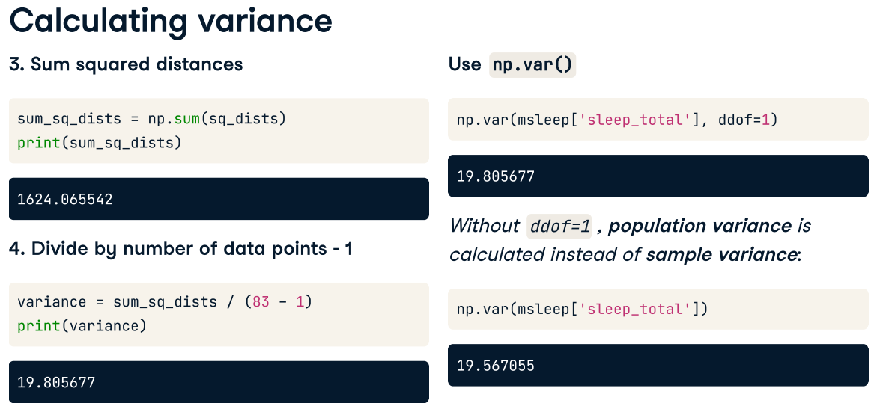
We can calculate the variance in one step using np.var, setting the ddof argument to 1. If we don't specify ddof equals 1, a slightly different formula is used to calculate variance that should only be used on a full population, not a sample.

Slide 20
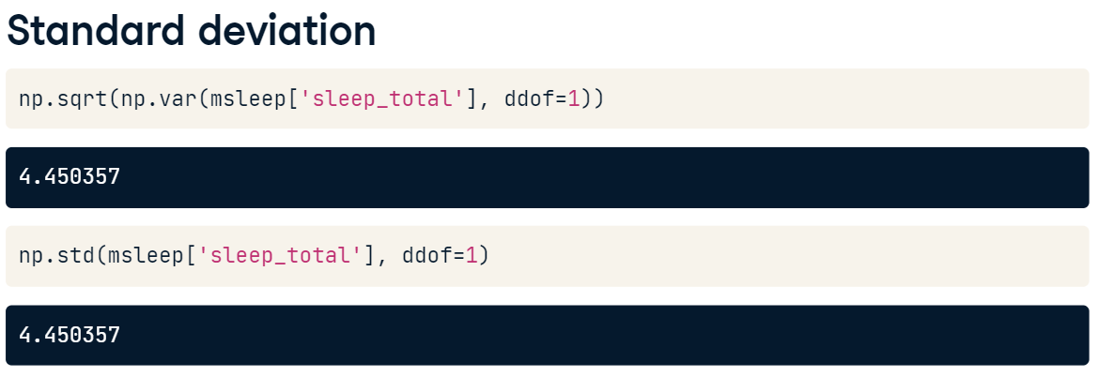
Standard deviation
The standard deviation is another measure of spread, calculated by taking the square root of the variance. It can be calculated using np.std. Just like np.var, we need to set ddof to 1. The nice thing about standard deviation is that the units are usually easier to understand since they're not squared. It's easier to wrap your head around 4 and a half hours than 19.8 hours squared.

Slide 21
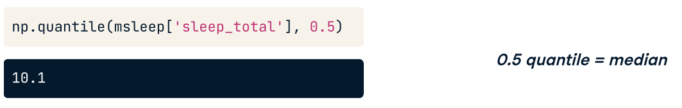
Quantiles
Quantiles, also called percentiles, split up the data into some number of equal parts.
Here, we call np.quantile, passing in the column of interest, followed by point-5. This gives us 10.1 hours, so 50% of mammals in the dataset sleep less than 10.1 hours a day, and the other 50% sleep more than 10.1 hours, so this is exactly the same as the median.

Slide 22
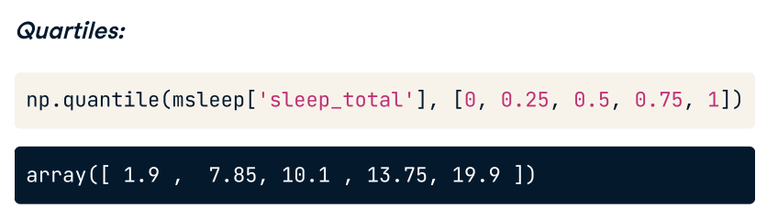
Quartiles
We can also pass in a list of numbers to get multiple quantiles at once. Here, we split the data into 4 equal parts. These are also called quartiles. This means that 25% of the data is between 1.9 and 7.85, another 25% is between 7.85 and 10.10, and so on.

Slide 23
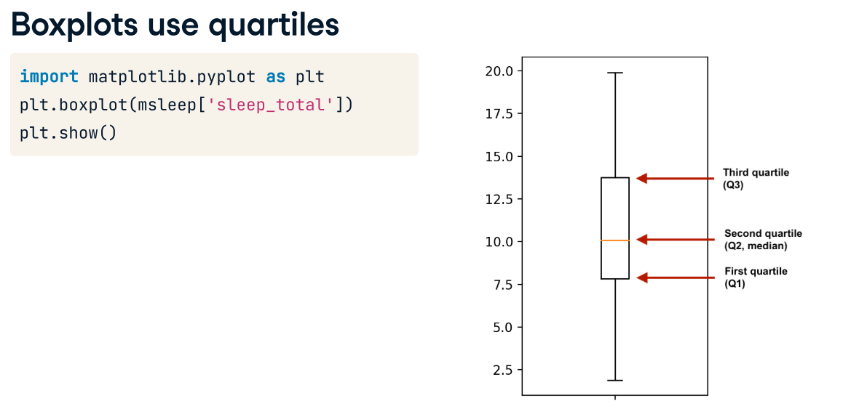
600
550
(IQR (400-300) * 1.5) + Q3
400
350
300
For example, out of 100 students
25% earns less than 300 baht
25% between 300 – 350 baht
50% earns less than 350 baht
The median is 350 baht.
275
150

Slide 24
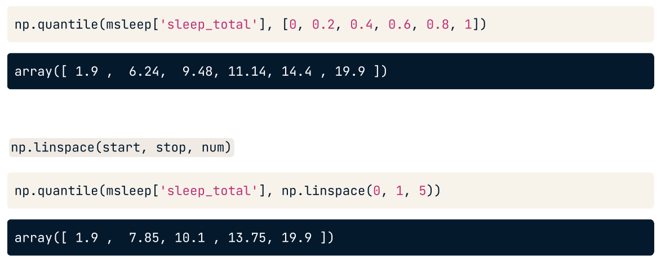
Quantiles using np.linspace()

Slide 25
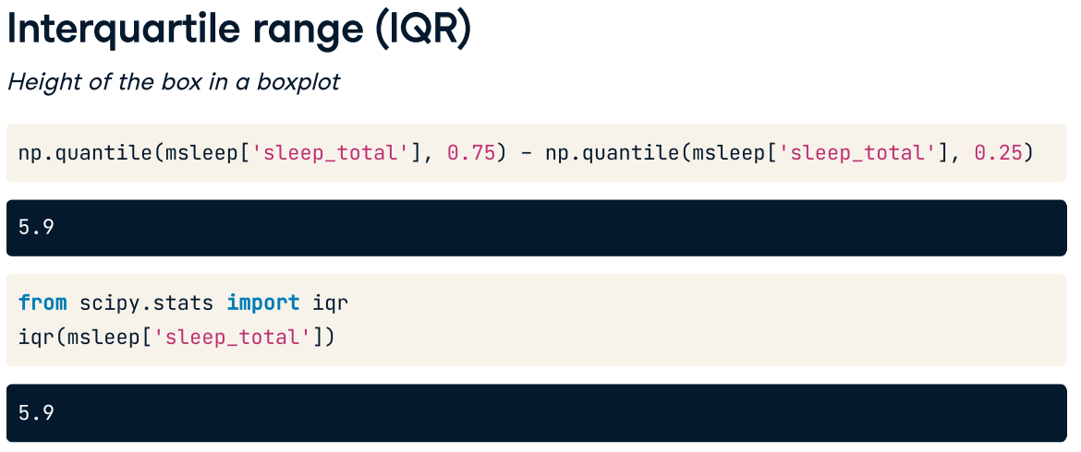
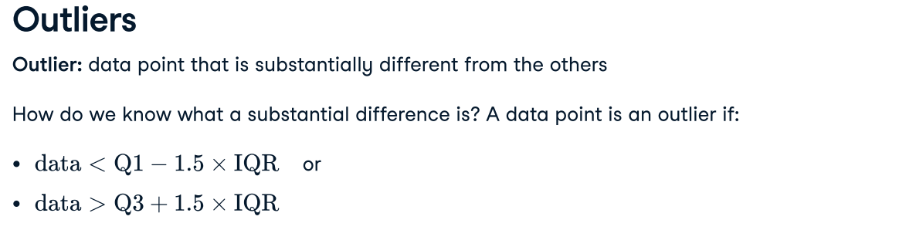
600
(IQR (400-300) * 1.5) + Q3 =
550
400
350
Any data points that is higher than 550 and is lower than 150 baht, they are considered as outliers.
In some scenarios, outliers should be removed before performing data analysis. This is to ensure that outliers will not affect summary statistics.
300
275
150

Slide 26
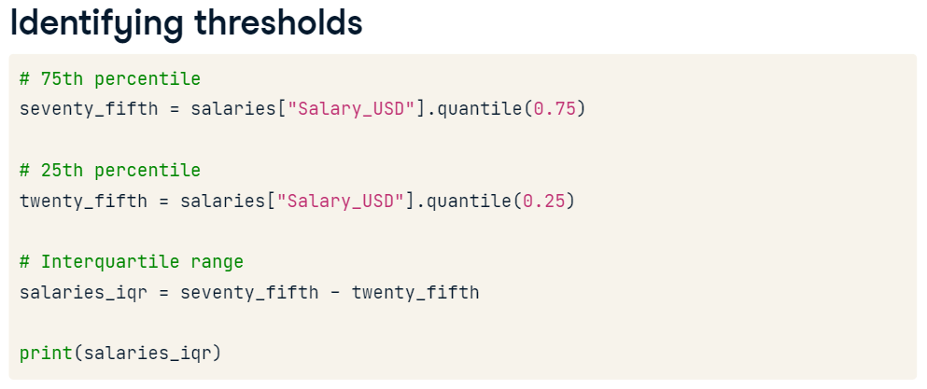
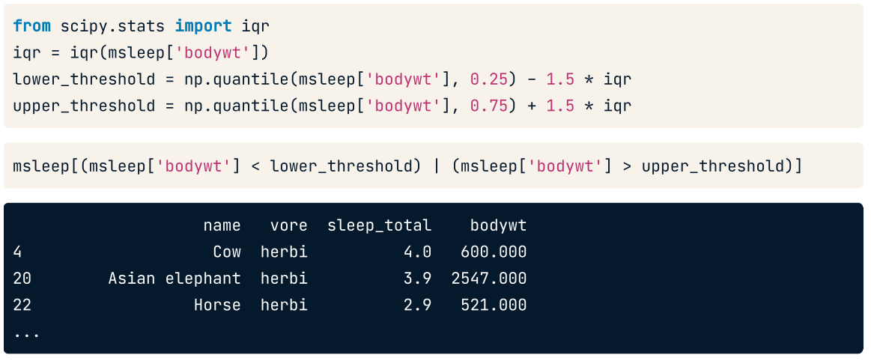

Slide 27
Complete the following tasks.
Calculate the quartiles of the co2_emission column of food_consumption.
Calculate the six quantiles that split up the data into 5 pieces (quintiles) of the co2_emission column of food_consumption.
Calculate the eleven quantiles of co2_emission that split up the data into ten pieces (deciles).
# Calculate the quartiles of co2_emission
print(np.quantile(food_consumption['co2_emission'],[0,0.25,0.5,0.75,1]))
# Calculate the quintiles of co2_emission
print(np.quantile(food_consumption['co2_emission’],[0,0.2,0.4,0.6,0.8,1]))
# Calculate the deciles of co2_emission
print(np.quantile(food_consumption['co2_emission’],[0,0.1,0.2,0.3,0.4,0.5,0.6,0.7,0.8,0.9,1]))

Slide 28
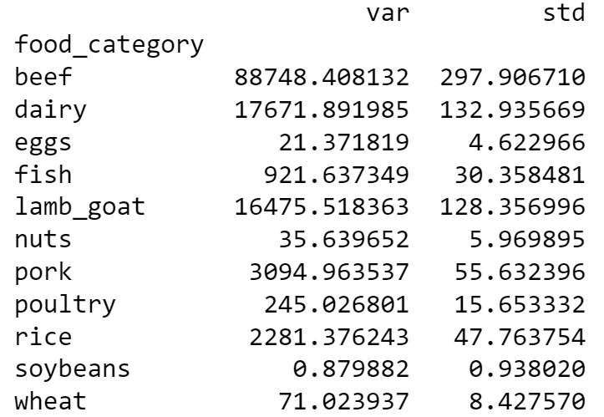
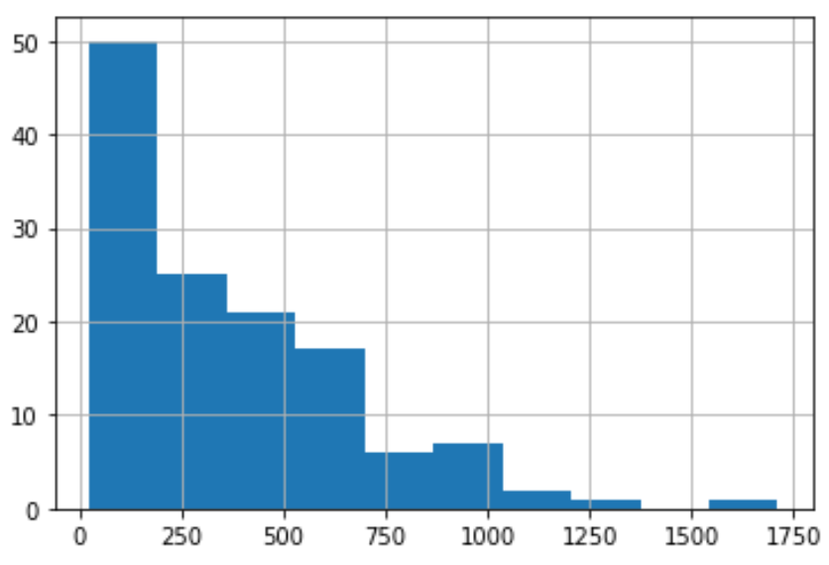
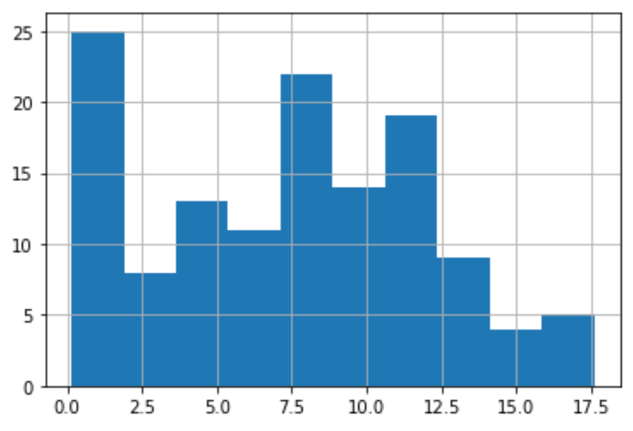
Complete the following tasks
Calculate the variance and standard deviation of co2_emission for each food_category by grouping (groupby food_category) and aggregating.
Create a histogram of co2_emission for the beef food_category and show the plot. (subset food_category for beef, select co2_emission column and plot .hist())
Create a histogram of co2_emission for the eggs food_category and show the plot.
# Print variance and sd of co2_emission for each food_category
print(food_consumption.groupby('food_category')['co2_emission'].agg(['var', 'std']))
# Import matplotlib.pyplot with alias plt
import matplotlib.pyplot as plt
# Create histogram of co2_emission for food_category 'beef'
food_consumption[food_consumption['food_category'] == 'beef']['co2_emission'].hist()
# Show plot
plt.show()
# Create histogram of co2_emission for food_category 'eggs'
food_consumption[food_consumption['food_category'] == 'eggs']['co2_emission'].hist()
plt.show()

Slide 29
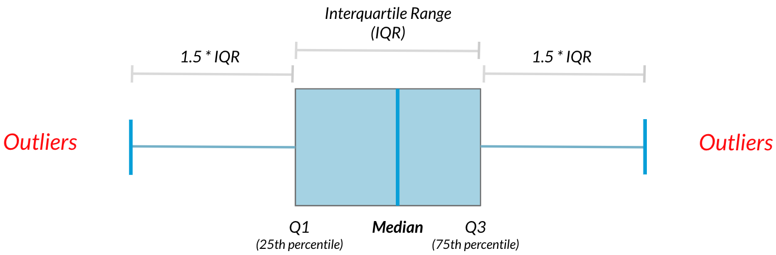
Finding outliers using IQR
Outliers can have big effects on statistics like mean, as well as statistics that rely on the mean, such as variance and standard deviation. Interquartile range, or IQR, is another way of measuring spread that's less influenced by outliers. IQR is also often used to find outliers. If a value is less than Q1−1.5×IQR or greater than Q3+1.5×IQR, it's considered an outlier.
Subset emissions_by_country to get countries with a total emission greater than the upper cutoff or a total emission less than the lower cutoff.
Compute the first and third quartiles of emissions_by_country and store these as q1 and q3.
Calculate the interquartile range of emissions_by_country and store it as iqr.
Calculate the lower and upper cutoffs for outliers of emissions_by_country, and store these as lower and upper.
Subset emissions_by_country to get countries with a total emission greater than the upper cutoff or a total emission less than the lower cutoff.
# Calculate total co2_emission per country: emissions_by_country
emissions_by_country = food_consumption.groupby('country')['co2_emission'].sum()
# Compute the first and third quantiles and IQR of emissions_by_country
q1 = np.quantile(emissions_by_country, 0.25)
q3 = np.quantile(emissions_by_country, 0.75)
iqr = q3 - q1
# Calculate the lower and upper cutoffs for outliers
lower = q1 - 1.5 * iqr
upper = q3 + 1.5 * iqr
# Subset emissions_by_country to find outliers
outliers = emissions_by_country[(emissions_by_country < lower) | (emissions_by_country > upper)]
print(outliers)

Slide 30
# Calculate total co2_emission per country: emissions_by_country
emissions_by_country = food_consumption.groupby('country')['co2_emission'].sum()
# Compute the first and third quantiles and IQR of emissions_by_country
q1 = np.quantile(emissions_by_country, 0.25)
q3 = np.quantile(emissions_by_country, 0.75)
iqr = q3 - q1
# Calculate the lower and upper cutoffs for outliers
lower = q1 - 1.5 * iqr
upper = q3 + 1.5 * iqr
# Subset emissions_by_country to find outliers
outliers = emissions_by_country[(emissions_by_country < lower) | (emissions_by_country > upper)]
print(outliers)

Slide 31
What are chances?
People talk about chance pretty frequently, like what are the chances of closing a sale, of rain tomorrow, or of winning a game? But how exactly do we measure chance?

Slide 32
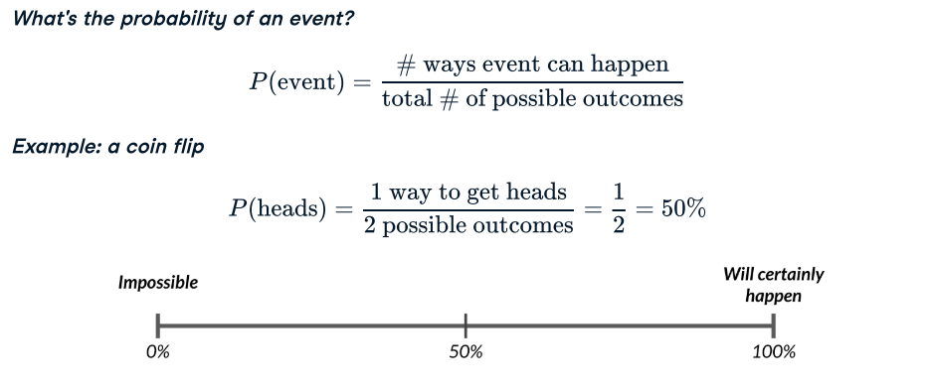
Measuring chance
We can measure the chances of an event using probability. We can calculate the probability of some event by taking the number of ways the event can happen and dividing it by the total number of possible outcomes.
For example, if we flip a coin, it can land on either heads or tails. To get the probability of the coin landing on heads, we divide the 1 way to get heads by the two possible outcomes, heads and tails.

Slide 33
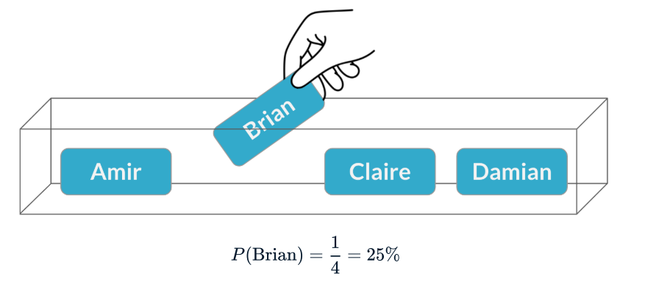
Scenario
Let's look at a more complex scenario. There's a meeting coming up with a potential client, and we want to send someone from the sales team to the meeting. We'll put each person's name on a ticket in a box and pull one out randomly to decide who goes to the meeting.
Brian's name gets pulled out. The probability of Brian being selected is one out of four, or 25%.

Slide 34
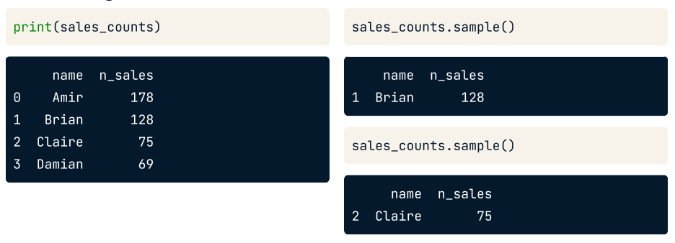
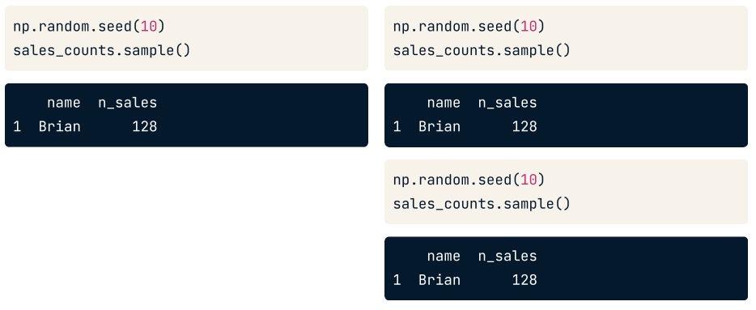
Sampling from a DataFrame
We can recreate this scenario in Python using the sample() method. By default, it randomly samples one row from the DataFrame.
To ensure the same results are obtained when we run the script in front of the team, the random seed is to be set.

Slide 35
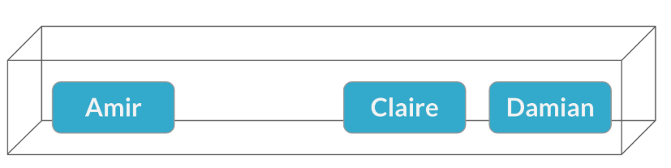
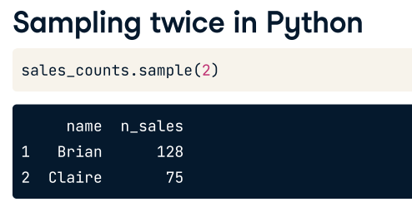
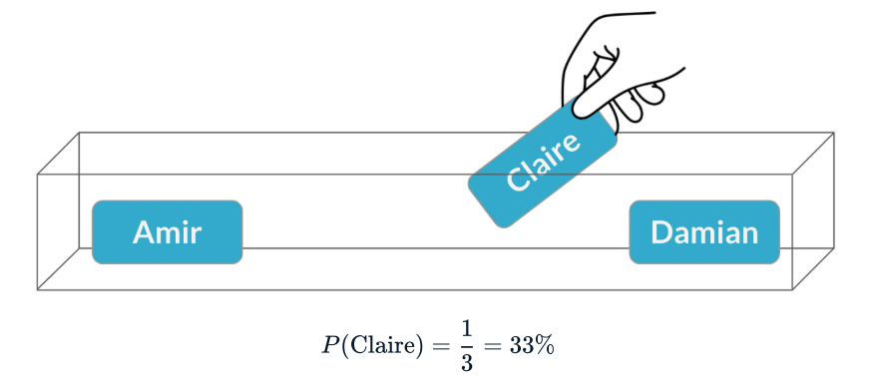
Scenario – a second meeting (sampling without replacement)
Now there's another potential client who wants to meet at the same time, so we need to pick another salesperson. Brian has already been picked, and he can't be in two meetings at once, so we'll pick between the remaining three. This is called sampling without replacement since we aren't replacing the name we already pulled out.
This time, Claire is picked, and the probability of this is one out of three, or about 33%.
To recreate this in Python, we can pass 2 into the sample method, which will give us 2 rows of the DataFrame.

Slide 36
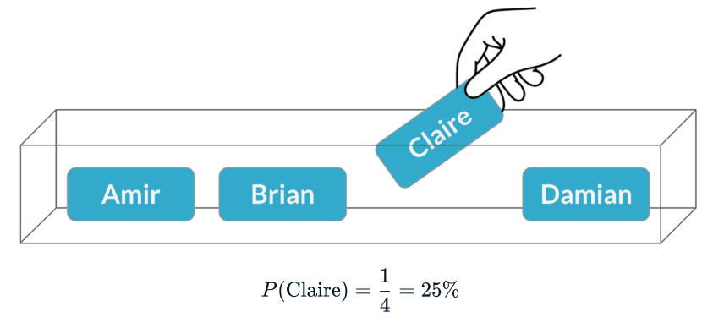
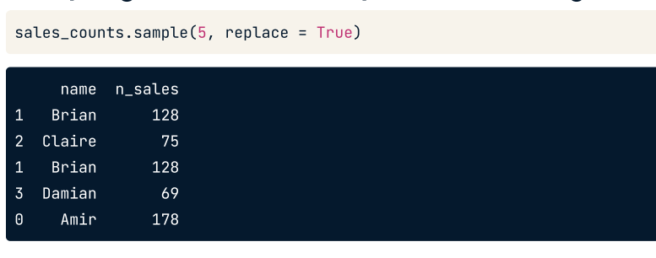
Sampling with replacement
Now let's say the two meetings are happening on different days, so the same person could attend both. In this scenario, we need to return Brian's name to the box after picking it. This is called sampling with replacement.
Claire gets picked for the second meeting, but this time, the probability of picking her is 25%.

Slide 37
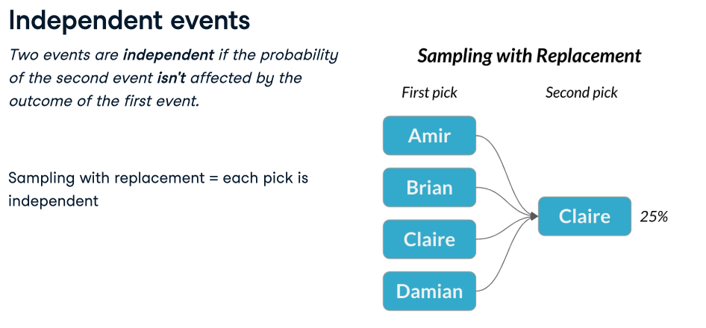
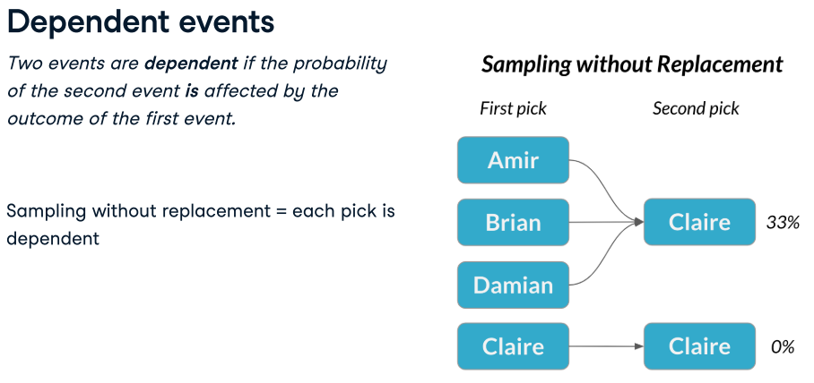

Slide 38
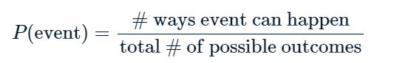
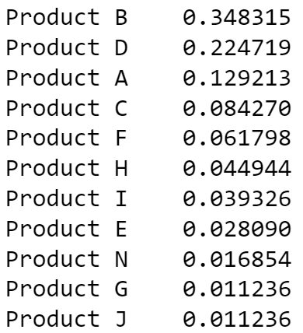
Calculating probabilities
You're in charge of the sales team, and it's time for performance reviews, starting with Amir. As part of the review, you want to randomly select a few of the deals that he's worked on over the past year so that you can look at them more deeply. Before you start selecting deals, you'll first figure out what the chances are of selecting certain deals.
Complete the following tasks.
Load amir_deals.csv to amir_deals
Count the number of deals Amir worked on for each product type and store in counts.
Calculate the probability of selecting a deal for the different product types by dividing the counts by the total number of deals Amir worked on. Save this as probs.
If you randomly select one of Amir's deals, what's the probability that the deal will involve Product C? (15%, 80.43%, 8.43%, 22.5% or 124.3%)
amir_deals = pd.read_csv('amir_deals.csv')
# Count the deals for each product
counts = amir_deals['product'].value_counts()
# Calculate probability of picking a deal with each product
probs = counts / amir_deals.shape[0]
print(probs)

Slide 39
Sampling deals
In the previous exercise, you counted the deals Amir worked on. Now it's time to randomly pick five deals so that you can reach out to each customer and ask if they were satisfied with the service they received. You'll try doing this both with and without replacement.
Additionally, you want to make sure this is done randomly and that it can be reproduced in case you get asked how you chose the deals, so you'll need to set the random seed before sampling from the deals.
Complete the following tasks.
Set the random seed to 24.
Take a sample of 5 deals without replacement and store them as sample_without_replacement.
Take a sample of 5 deals with replacement and save as sample_with_replacement.
# Set random seed
np.random.seed(24)
# Sample 5 deals without replacement
sample_without_replacement = amir_deals.sample(5)
print(sample_without_replacement)
# Sample 5 deals with replacement
sample_with_replacement = amir_deals.sample(5, replace=True)
print(sample_with_replacement)

Slide 40
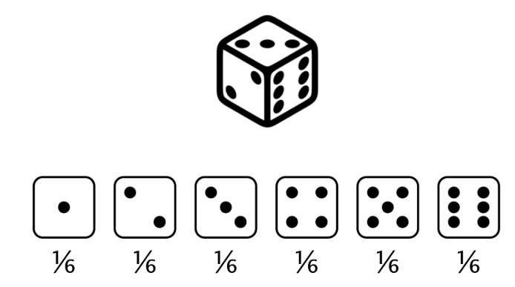
Discrete distributions
We will take a deeper dive into probability and begin looking at probability distributions.
Let's consider rolling a standard, six-sided die.
There are six numbers, or six possible outcomes, and every number has one sixth, or about a 17 percent chance of being rolled. This is an example of a probability distribution.

Slide 41
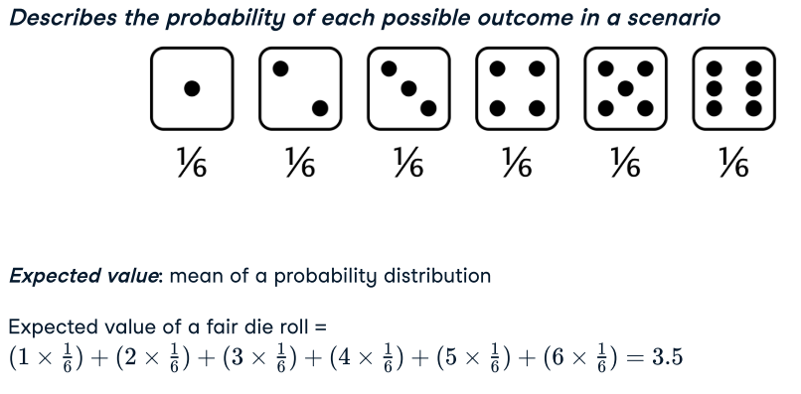
Probability Distribution
A probability distribution describes the probability of each possible outcome in a scenario. We can also talk about the expected value of a distribution, which is the mean of a distribution. We can calculate this by multiplying each value by its probability (one sixth in this case) and summing, so the expected value of rolling a fair die is 3.5.

Slide 42



We can calculate probabilities of different outcomes by taking areas of the probability distribution. For example, what's the probability that our die roll is less than or equal to 2?
Each bar has a width of 1 and a height of one sixth, so the area of each bar is one sixth. We'll sum the areas for 1 and 2, to get a total probability of one third.

Slide 43

Uneven die
Now let's say we have a die where the two got turned into a three. This means that we now have a 0% chance of getting a 2, and a 33% chance of getting a 3. To calculate the expected value of this die, we now multiply 2 by 0, since it's impossible to get a 2, and 3 by its new probability, one third. This gives us an expected value that's slightly higher than the fair die.

Slide 44



Slide 45



Slide 46



Slide 47
Creating a probability distribution
A new restaurant opened a few months ago, and the restaurant's management wants to optimize its seating space based on the size of the groups that come most often. On one night, there are 10 groups of people waiting to be seated at the restaurant, but instead of being called in the order they arrived, they will be called randomly. In this exercise, you'll investigate the probability of groups of different sizes getting picked first. Data on each of the ten groups is contained in the restaurant_groups (from restaurant_groups.csv) DataFrame.
Complete the following tasks
Create a histogram of the group_size column of restaurant_groups, setting bins to [2, 3, 4, 5, 6]. Remember to show the plot.
Count the number of each group_size in restaurant_groups, then divide by the number of rows in restaurant_groups to calculate the probability of randomly selecting a group of each size. Save as size_dist.
Reset the index of size_dist.
Rename the columns of size_dist to group_size and prob.
Calculate the expected value of the size_distribution, which represents the expected group size, by multiplying the group_size by the prob and taking the sum.
Calculate the probability of randomly picking a group of 4 or more people by subsetting for groups of size 4 or more and summing the probabilities of selecting those groups.

Slide 48

restaurant_groups = pd.read_csv('restaurant_groups.csv')
restaurant_groups['group_size'].hist(bins=[2,3,4,5,6])
plt.show()
# Create probability distribution
size_dist = restaurant_groups['group_size'].value_counts() / restaurant_groups.shape[0]
# Reset index and rename columns
size_dist = size_dist.reset_index()
size_dist.columns = ['group_size', 'prob']
print(size_dist)
# Expected value
expected_value = np.sum(size_dist['group_size'] * size_dist['prob'])
print('The expected value is', expected_value)
# Subset groups of size 4 or more
groups_4_or_more = size_dist[size_dist['group_size'] >= 4]
# Sum the probabilities of groups_4_or_more
prob_4_or_more = np.sum(groups_4_or_more['prob'])
print('The probability is ',prob_4_or_more)

Slide 49


Slide 50

Continuous distributions
We can use discrete distributions to model situations that involve discrete or countable variables, but how can we model continuous variables?
Let's start with an example. The city bus arrives once every twelve minutes, so if you show up at a random time, you could wait anywhere from 0 minutes if you just arrive as the bus pulls in, up to 12 minutes if you arrive just as the bus leaves.

Slide 51

Let’s model a scenario
Let's model this scenario with a probability distribution. There are an infinite number of minutes we could wait since we could wait 1 minute, 1.5 minutes, 1.53 minutes, and so on, so we can't create individual blocks like we could with a discrete variable.
Instead, we'll use a continuous line to represent probability. The line is flat since there's the same probability of waiting any time from 0 to 12 minutes. This is called the continuous uniform distribution.

Slide 52

Probability still = area
Now that we have our distribution, let's figure out what the probability is that we'll wait between 4 and 7 minutes. Just like with discrete distributions, we can take the area from 4 to 7 to calculate probability.
The width of this rectangle is 7 minus 4 which is 3. The height is one twelfth.
Multiplying those together to get area, we get 3/12 or 25%.

Slide 53


Uniform distribution in Python
Let's use the uniform distribution in Python to calculate the probability of waiting 7 minutes or less. We need to import uniform from scipy.stats. We can call uniform.cdf and pass it 7, followed by the lower and upper limits, which in our case is 0 and 12. The probability of waiting less than 7 minutes is about 58%.
If we want the probability of waiting more than 7 minutes, we need to take 1 minus the probability of waiting less than 7 minutes.

Slide 54



Slide 55



Slide 56
Practice – Data back-ups
The sales software used at your company is set to automatically back itself up, but no one knows exactly what time the back-ups happen. It is known, however, that back-ups happen exactly every 30 minutes. Amir comes back from sales meetings at random times to update the data on the client he just met with. He wants to know how long he'll have to wait for his newly-entered data to get backed up. Use your new knowledge of continuous uniform distributions to model this situation and answer Amir's questions.
To model how long Amir will wait for a back-up using a continuous uniform distribution, save his lowest possible wait time as min_time and his longest possible wait time as max_time. Remember that back-ups happen every 30 minutes.
Import uniform from scipy.stats and calculate the probability that Amir has to wait less than 5 minutes, and store in a variable called prob_less_than_5.
Calculate the probability that Amir has to wait more than 5 minutes, and store in a variable called prob_greater_than_5.
Calculate the probability that Amir has to wait between 10 and 20 minutes, and store in a variable called prob_between_10_and_20.

Slide 57
Practice – Data back-ups
min_time = 0
max_time = 30
# Import uniform from scipy.stats
from scipy.stats import uniform
:
:
# Calculate probability of waiting more than 5 mins
prob_greater_than_5 = 1-uniform.cdf(5,0,30)
print(prob_greater_than_5)
# Calculate probability of waiting 10-20 mins
prob_between_10_and_20 = uniform.cdf(20,0,30)-uniform.cdf(10,0,30)
print(prob_between_10_and_20)

Slide 58
Simulating wait times
To give Amir a better idea of how long he'll have to wait, you'll simulate Amir waiting 1000 times and create a histogram to show him what he should expect. Recall from the last exercise that his minimum wait time is 0 minutes, and his maximum wait time is 30 minutes.
Set the random seed to 334.
Generate 1000 wait times from the continuous uniform distribution that models Amir's wait time. Save this as wait_times.
Create a histogram of the simulated wait times and show the plot.
# Set random seed to 334
np.random.seed(334)
# Import uniform
from scipy.stats import uniform
# Generate 1000 wait times between 0 and 30 mins
wait_times = uniform.rvs(0, 30, size=1000)
# Create a histogram of simulated times and show plot
plt.hist(wait_times)
plt.show()

Slide 59



Normal distribution
It's one of the most important probability distributions you'll learn about since a countless number of statistical methods rely on it, and it applies to more real-world situations than the distributions we've covered so far.
The normal distribution looks like a "bell curve".
First, it's symmetrical, so the left side is a mirror image of the right.
Second, just like any continuous distribution, the area beneath the curve is 1.
The probability never hits 0, even if it looks like it does at the tail ends. Only 0.006% of its area is contained beyond the edges of this graph.

Slide 60


Slide 61



This is sometimes called the 68-95-99.7 rule.

Slide 62

There's lots of real-world data shaped like the normal distribution. For example, here is a histogram of the heights of women that participated in the National Health and Nutrition Examination Survey. The mean height is around 161 centimeters, and the standard deviation is about 7 centimeters.

Slide 63



Slide 64



Slide 65


The central limit theorem

Slide 66



Slide 67


This phenomenon is known as the central limit theorem, which states that a sampling distribution will approach a normal distribution as the number of trials increases. In our example, the sampling distribution became closer to the normal distribution as we took more and more sample means. It's important to note that the central limit theorem only applies when samples are taken randomly and are independent, for example, randomly picking sales deals with replacement.

Slide 68
Central Limit Theorem in action
The central limit theorem states that a sampling distribution of a sample statistic approaches the normal distribution as you take more samples, no matter the original distribution being sampled from.
In this exercise, you'll focus on the sample mean and see the central limit theorem in action while examining the num_users column of amir_deals more closely, which contains the number of people who intend to use the product Amir is selling.

Slide 69

Create a histogram of the num_users column of amir_deals and show the plot.
Set the seed to 104.
Take a sample of size 20 with replacement from the num_users column of amir_deals, and take the mean.
Repeat this 100 times using a for loop and store as sample_means. This will take 100 different samples and calculate the mean of each.
Convert sample_means into a pd.Series, create a histogram of the sample_means, and show the plot.
# Set seed to 104
np.random.seed(104)
sample_means = []
# Loop 100 times
for i in range(100):
# Take sample of 20 num_users
samp_20 = amir_deals['num_users'].sample(20, replace=True)
# Calculate mean of samp_20
samp_20_mean = np.mean(samp_20)
# Append samp_20_mean to sample_means
sample_means.append(samp_20_mean)
# Convert to Series and plot histogram
sample_means_series = pd.Series(sample_means)
sample_means_series.hist()
# Show plot
plt.show()

Slide 70
Correlation

Slide 71





Slide 72





Slide 73



Slide 74


Slide 75
Relationships between variables
You'll be working with a dataset world_happiness containing results from the 2019 World Happiness Report. The report scores various countries based on how happy people in that country are. It also ranks each country on various societal aspects such as social support, freedom, corruption, and others. The dataset also includes the GDP per capita and life expectancy for each country.
In this exercise, you'll examine the relationship between a country's life expectancy (life_exp) and happiness score (happiness_score) both visually and quantitatively.
world_happiness is loaded from world_happiness.csv.

Slide 76
Create a scatterplot of happiness_score vs. life_exp (without a trendline) using seaborn.
Show the plot.
Create a scatterplot of happiness_score vs. life_exp with a linear trendline using seaborn, setting ci to None.
Show the plot.
Based on the scatterplot shown, which is most likely be the correlation between the two values?
0.3, -0.3, 0.8, -0.8
Calculate the correlation between life_exp and happiness_score. Save this as cor.
# Create a scatterplot of happiness_score vs. life_exp and show
sns.scatterplot(x='life_exp', y='happiness_score', data=world_happiness)
plt.show()
# Create scatterplot of happiness_score vs life_exp with trendline
sns.lmplot(x='life_exp', y='happiness_score', data=world_happiness)
plt.show()
# Correlation between life_exp and happiness_score
cor = world_happiness['life_exp'].corr(world_happiness['happiness_score'])
print(cor)

Slide 77


Correlation caveats
Consider the graph. There is clearly a relationship between x and y, but when we calculate the correlation, we get 0.18.
This is because the relationship between the two variables is a quadratic relationship, not a linear relationship. The correlation coefficient measures the strength of linear relationships, and linear relationships only.

Slide 78



If we take a closer look at the distribution for bodywt, it's highly skewed. There are lots of lower weights and a few weights that are much higher than the rest.

Slide 79

Log transformation
When data is highly skewed like this, we can apply a log transformation.
We'll create a new column called log_bodywt which holds the log of each body weight. We can do this using np.log. If we plot the log of bodyweight versus awake time, the relationship looks much more linear than the one between regular bodyweight and awake time. The correlation between the log of bodyweight and awake time is about 0.57, which is much higher than the 0.3 we had before.

Slide 80

A phenomenon called confounding can lead to spurious correlations. Let's say we want to know if drinking coffee causes lung cancer. Looking at the data, we find that coffee drinking and lung cancer are correlated, which may lead us to think that drinking more coffee will give you lung cancer.
However, there is a third, hidden variable at play, which is smoking. It is also known that smoking causes lung cancer.
In reality, it turns out that coffee does not cause lung cancer and is only associated with it, but it appeared causal due to the third variable, smoking. This third variable is called a confounder, or lurking variable. This means that the relationship of interest between coffee and lung cancer is a spurious correlation.

Slide 81
Practice
Transforming variables
When variables have skewed distributions, they often require a transformation in order to form a linear relationship with another variable so that correlation can be computed. In this exercise, you'll perform a transformation yourself.
Work with world_happiness DataFrame
Complete the following tasks.
Create a scatterplot of happiness_score versus gdp_per_cap and calculate the correlation between them.
Add a new column to world_happiness called log_gdp_per_cap that contains the log of gdp_per_cap.
Create a seaborn scatterplot of happiness_score versus log_gdp_per_cap.
Calculate the correlation between log_gdp_per_cap and happiness_score.

Slide 82
# Create log_gdp_per_cap column
world_happiness['log_gdp_per_cap'] = np.log(world_happiness['gdp_per_cap’])
# Scatter plot of happiness_score vs. log_gdp_per_cap
sns.scatterplot(x='log_gdp_per_cap', y='happiness_score', data=world_happiness)
plt.show()
# Calculate correlation
cor = world_happiness['log_gdp_per_cap'].corr(world_happiness['happiness_score’])
print(cor)

